Slide 1

A PRESENTATION TO HAGITAL CONSULTING LIMITED
SCOTCH PIZZAS
ON
DATA ANALYSIS PROJECT
TITLED:
SCOTCH PIZZAS
PRESENTED BY TEAM FIVE (5) MEMBERS

Slide 2
TEAM FIVE (5) MEMBERS
NONSO STANLEY AGANOKE - TEAM LED
EFFIONG JACOB – ASST. TEAM LED
OBIAGELI MONEME
AKINLABI OTEBOLAKU
LUKMON YAKUB
PRINCE CHINONSO ONYEMAKA
REMI AJALA
OLUBAMISE
OLONADE HAKEEM BABAJIDE (LUMPUR)

Slide 3
Brief Background and Objective of the Analysis
Scotch Pizzas chain, a renowned Pizza producing firm over the years have been matching up to the expected sumptuous taste of pizza lovers in the country. Different age groups have been patronizing the company but with different turnouts.
To some extent, the company have been generating data but yet to be analyzed.
The primary objective of this data set analysis is to identify customer behavior and preferences, popular pizzas and branches, pricing, inventory decisions, and operating performance.
Please note that the following data is an annual data and as such can only be compared within the year.

Slide 4
OUR DETAILED ANALYSIS

Slide 5
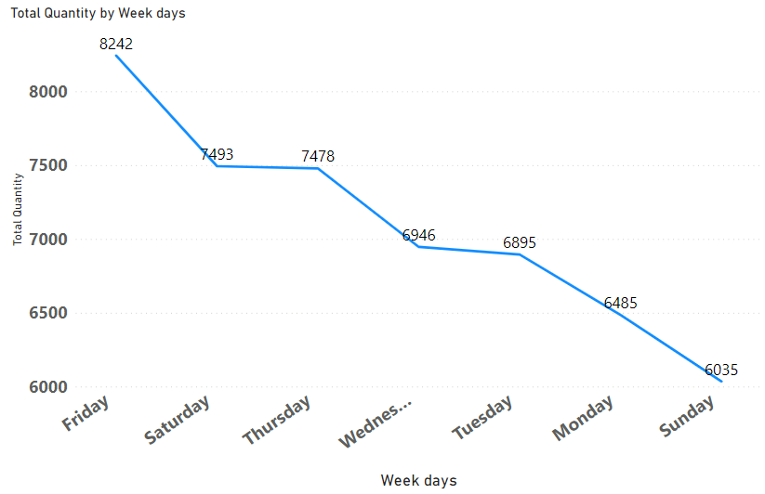
From our Analysis, we found out that on Fridays, more sales were made which may have been as a result of the fact that retailers may want to enjoy the weekend with a delightful Pizza. We also found out that less sales were made on Sundays which may have been as a result of the fact that many people rest from the weeks activities in preparation for a new week.

Slide 6
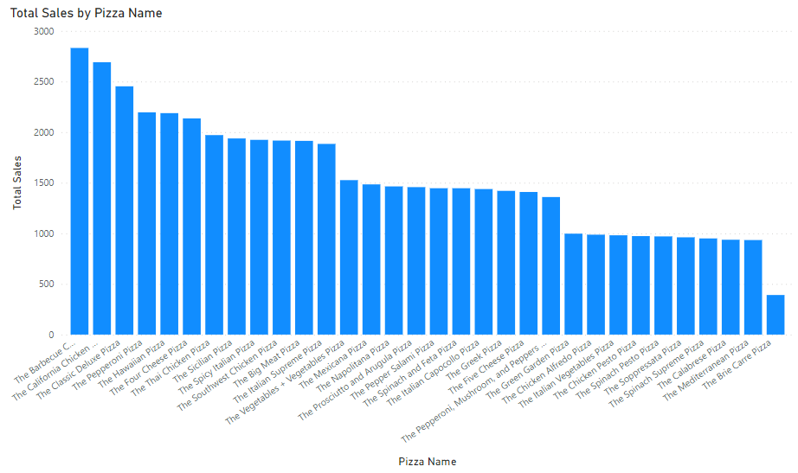
We found out that we sold more of the Barbecue and California Chicken Pizza while we sold less of the Brie Carrie Pizza during the time periods mentioned earlier which may have been as a result of customer preference

Slide 7
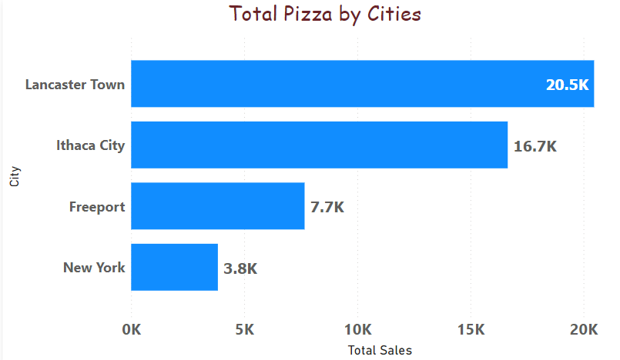
As we can see from the chart the city Lancaster town made the most Pizza sales while New York made the least

Slide 8
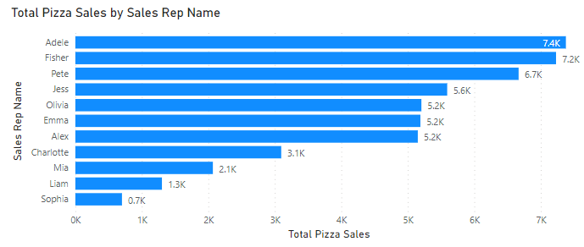
Adele and Fisher sales representatives made the highest sales with a difference of about $6.6K sales revenue from Sophia the least earning sales representative

Slide 9
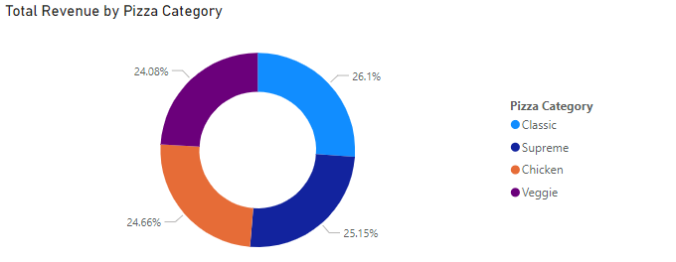
There are 4 pizza categories of which the most earning is the Classic Pizza Category which makes a 26% revenue of the total revenue which isn’t much different from other Pizza Categories as respected Supreme-25.15%, Chicken-24.66%, and Veggie-24.08%

Slide 10
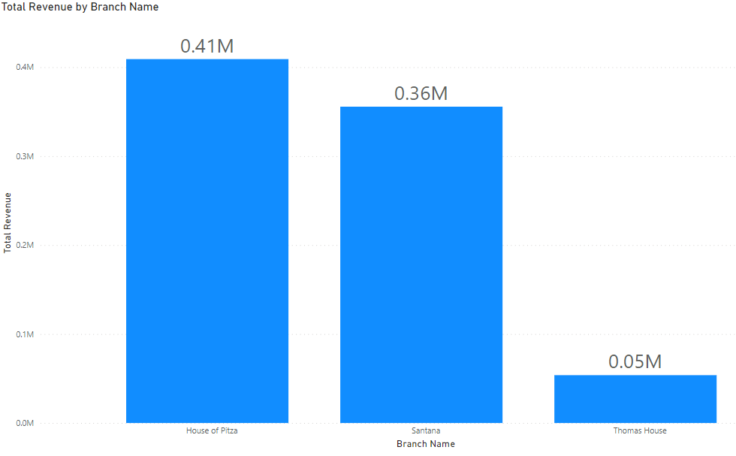
Here, we see that the House Of Pitza branch made the highest Revenue.

Slide 11
Limitations Of The Dataset
There was insufficient information to ascertain profitability of the company as a result of the absence of the cost of production of the Pizzas which is essential to the companies growth. But only the sales that the company made were what we worked with so as to get the revenue made.
There is not adequate information concerning the customers. However, we relied on the distinct count of the no. of orders made to presume the no. of customers

Slide 12
Important notifications
There was a total revenue of $818.58K made from the sales of the 33 Pizza types sold in the 4 cities in which the 3 individual branches are present.
The large size of all the types of Pizzas we sold seemed to be the most bought by the customers compared to other sizes.
The cheapest Pizza type offered by the company is the Peperoni Pizza which sells at a cost of about $10 while the most expensive is the Greek Pizza which costs about $36.
The stores open at about 11:00 am and closes at about 10:30 pm.

